Slide 1
TBI - Structure

Slide 2
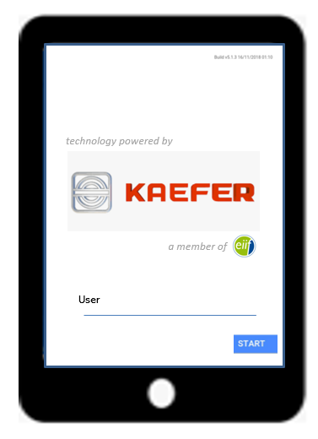

How to start TBI – both versions: TBI-easy and TBI-App
Welcome TBI Inspector
Please fill in your name
__________________________
Start
Welcome TBI Inspector
Please fill your name
_________________

Slide 3
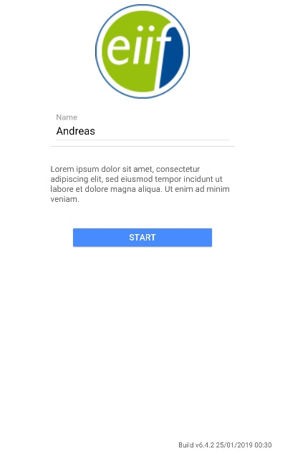
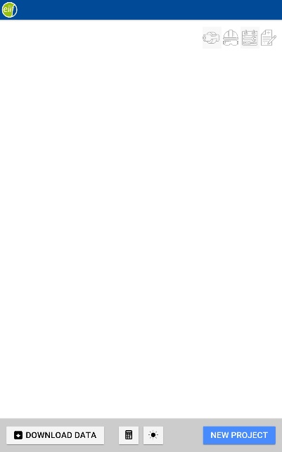
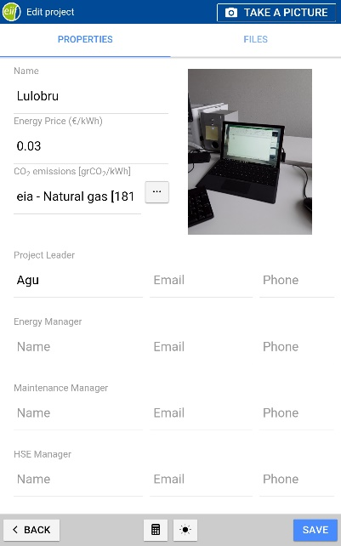
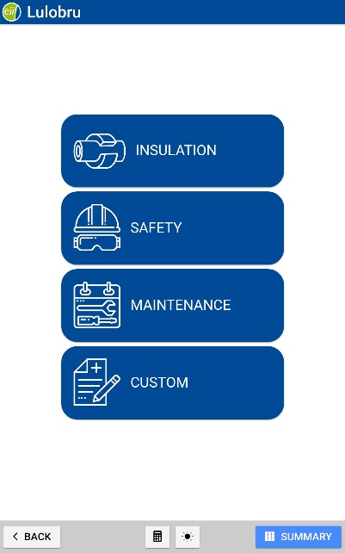
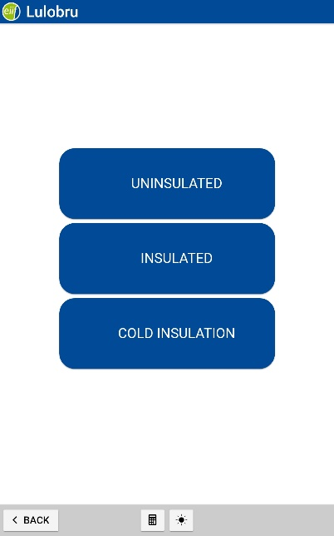
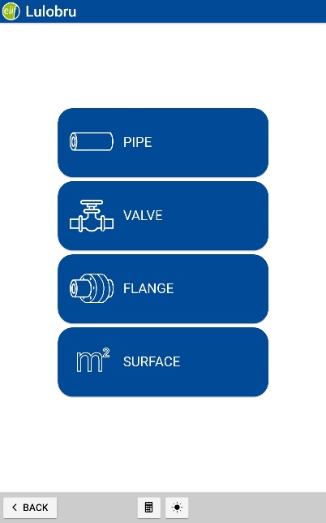
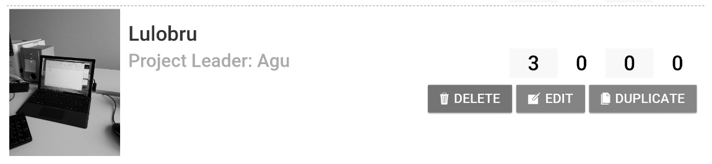
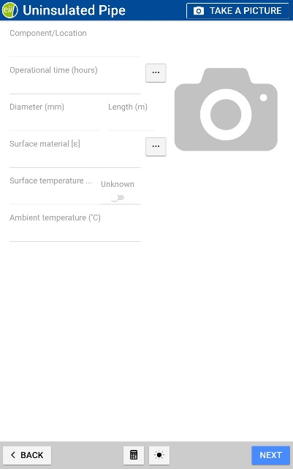
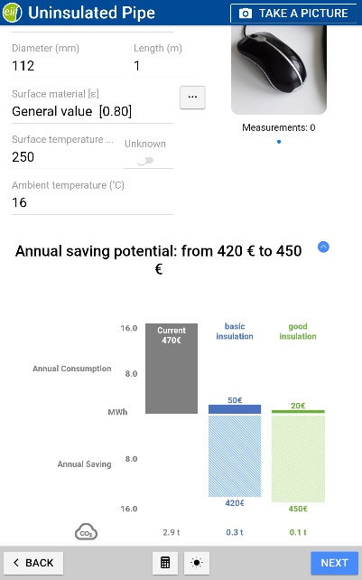
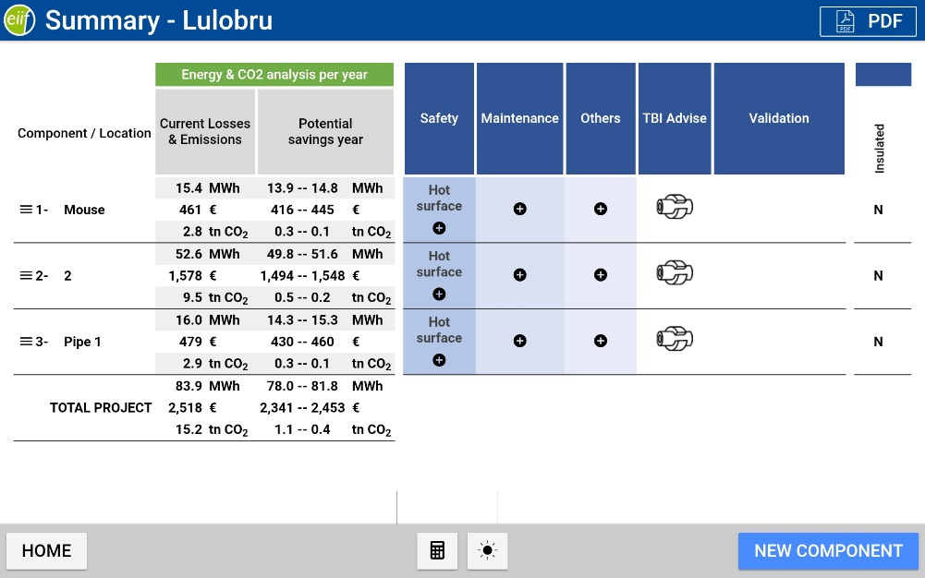
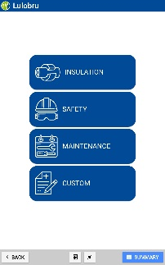
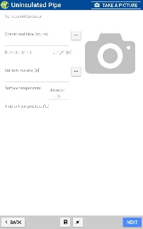
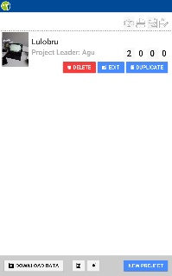

TBI App Pro V27
Your component and project have been saved.
What do you want to do next:
Continue (former NEW COMPONENT)
Start a new or change a project (former HOME)
Quit

Slide 4
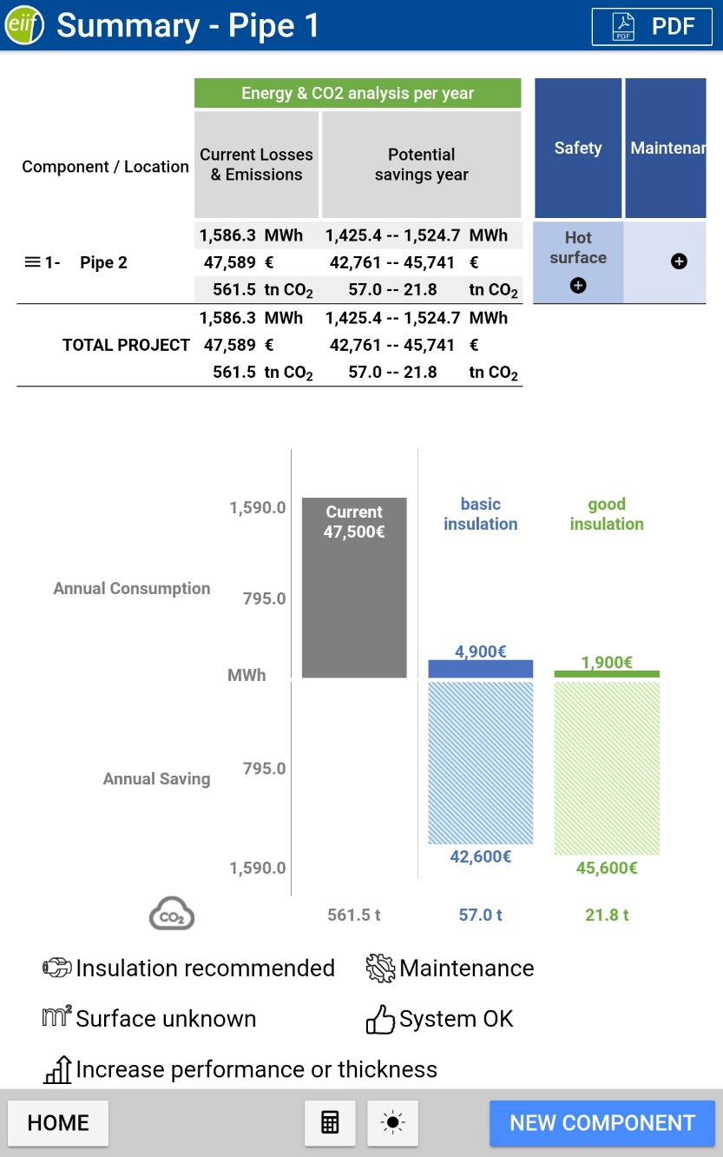
TBI App Pro V27
Your component and project have been saved.
What do you want to do next:
Continue (former NEW COMPONENT)
Start a new or change a project (former HOME)
Quit

Slide 5
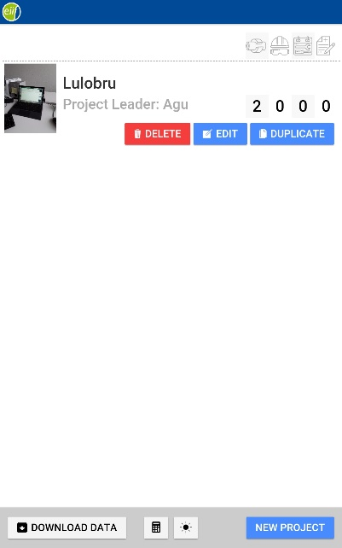
Start to Summary – Back at Project and clicking on the component

Slide 6


TBI App Easy
Preselected Project showing Energy and CO2
What do you want to do next:
New Component* (Please note: The previous one will be deleted!)
Save & Quit
You want to report more than one component?
Please go to www.eiif.org/tbi and upgrade to the TBI-App professional with unlimited components and project options (fees apply).

Slide 7
TBI App Easy
What do you want to do next:
New Component* (Please note: The previous one will be deleted!)
Save & Quit
You want to report more than one component?
Please go to www.eiif.org/tbi and upgrade to the TBI-App professional with unlimited components and project options (fees apply).

Slide 8
Contact

